Slide 1
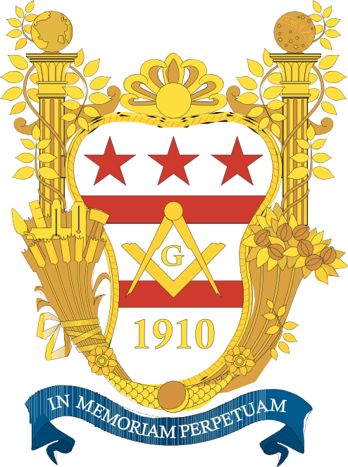
THE GEORGE WASHINGTON MASONIC NATIONAL
MEMORIAL ASSOCIATION

Slide 2
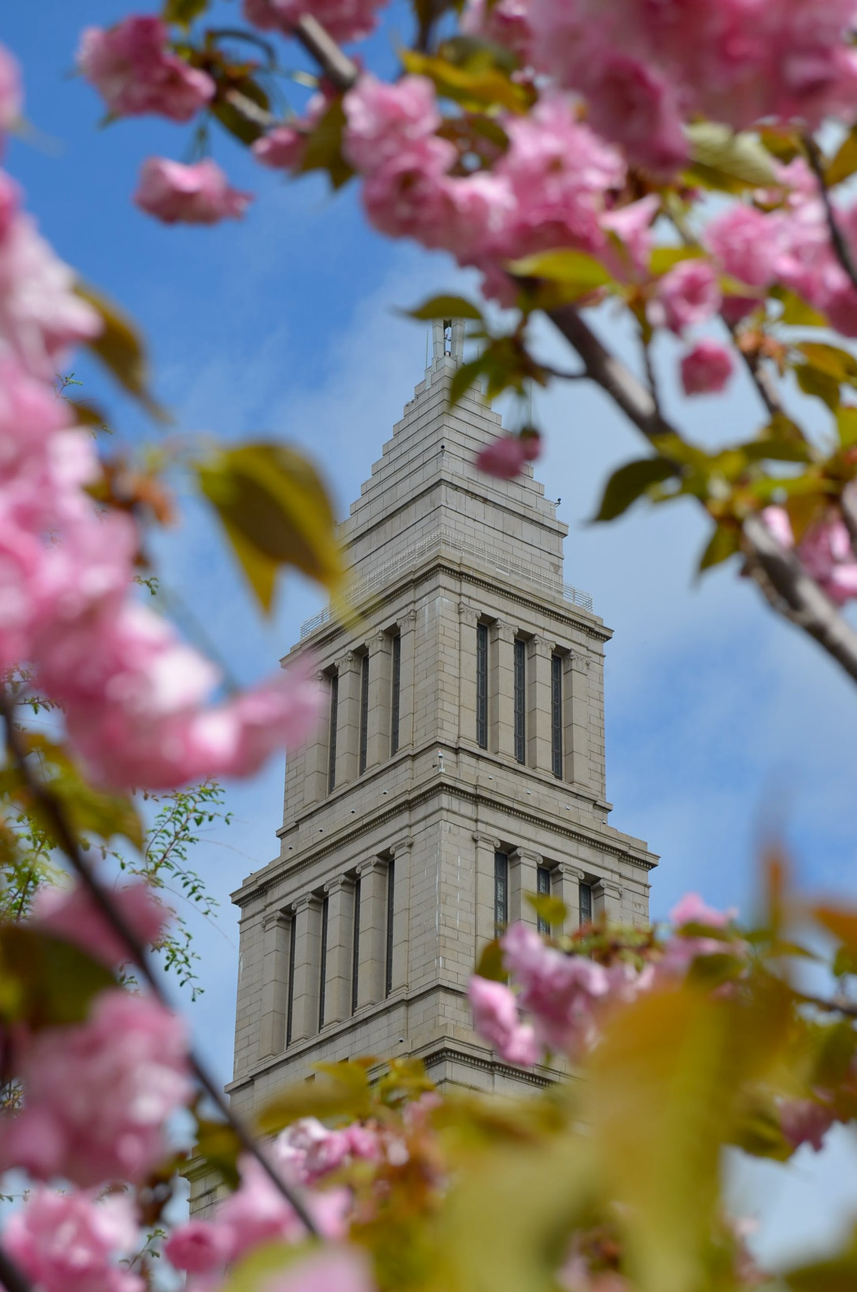
Our Vision
To inspire humanity through education
to emulate and promote the virtues, character, and vision of
George Washington, the Man, the Mason,
and Father of our Country.

Slide 3
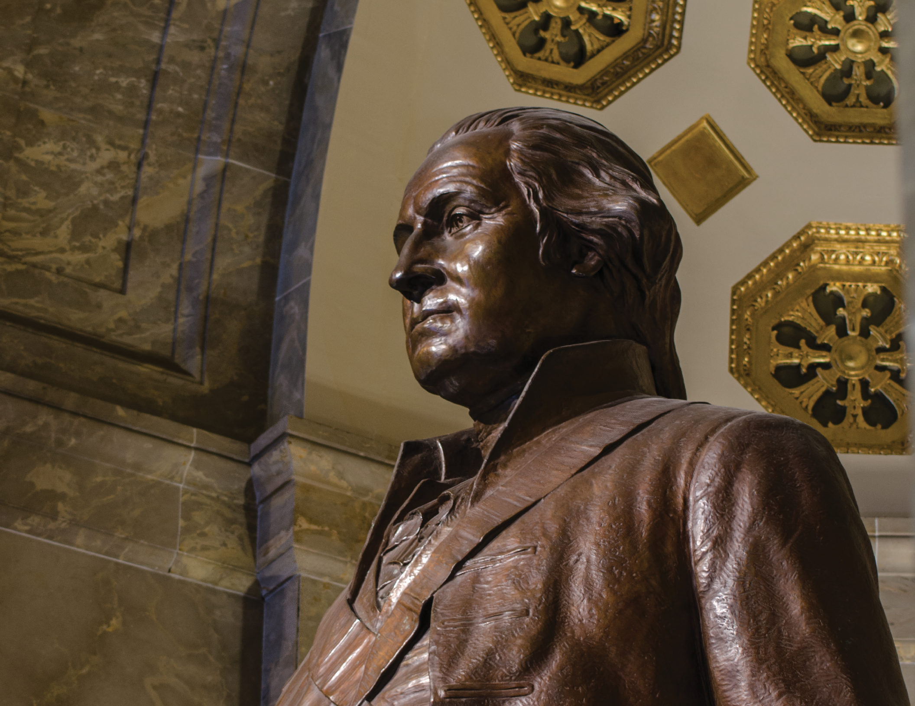

Slide 4
George Washington
Recognized Today as America’s Foremost Freemason
Brother Washington was
Initiated, Passed, and Raised in 1752 and 1753

Slide 5
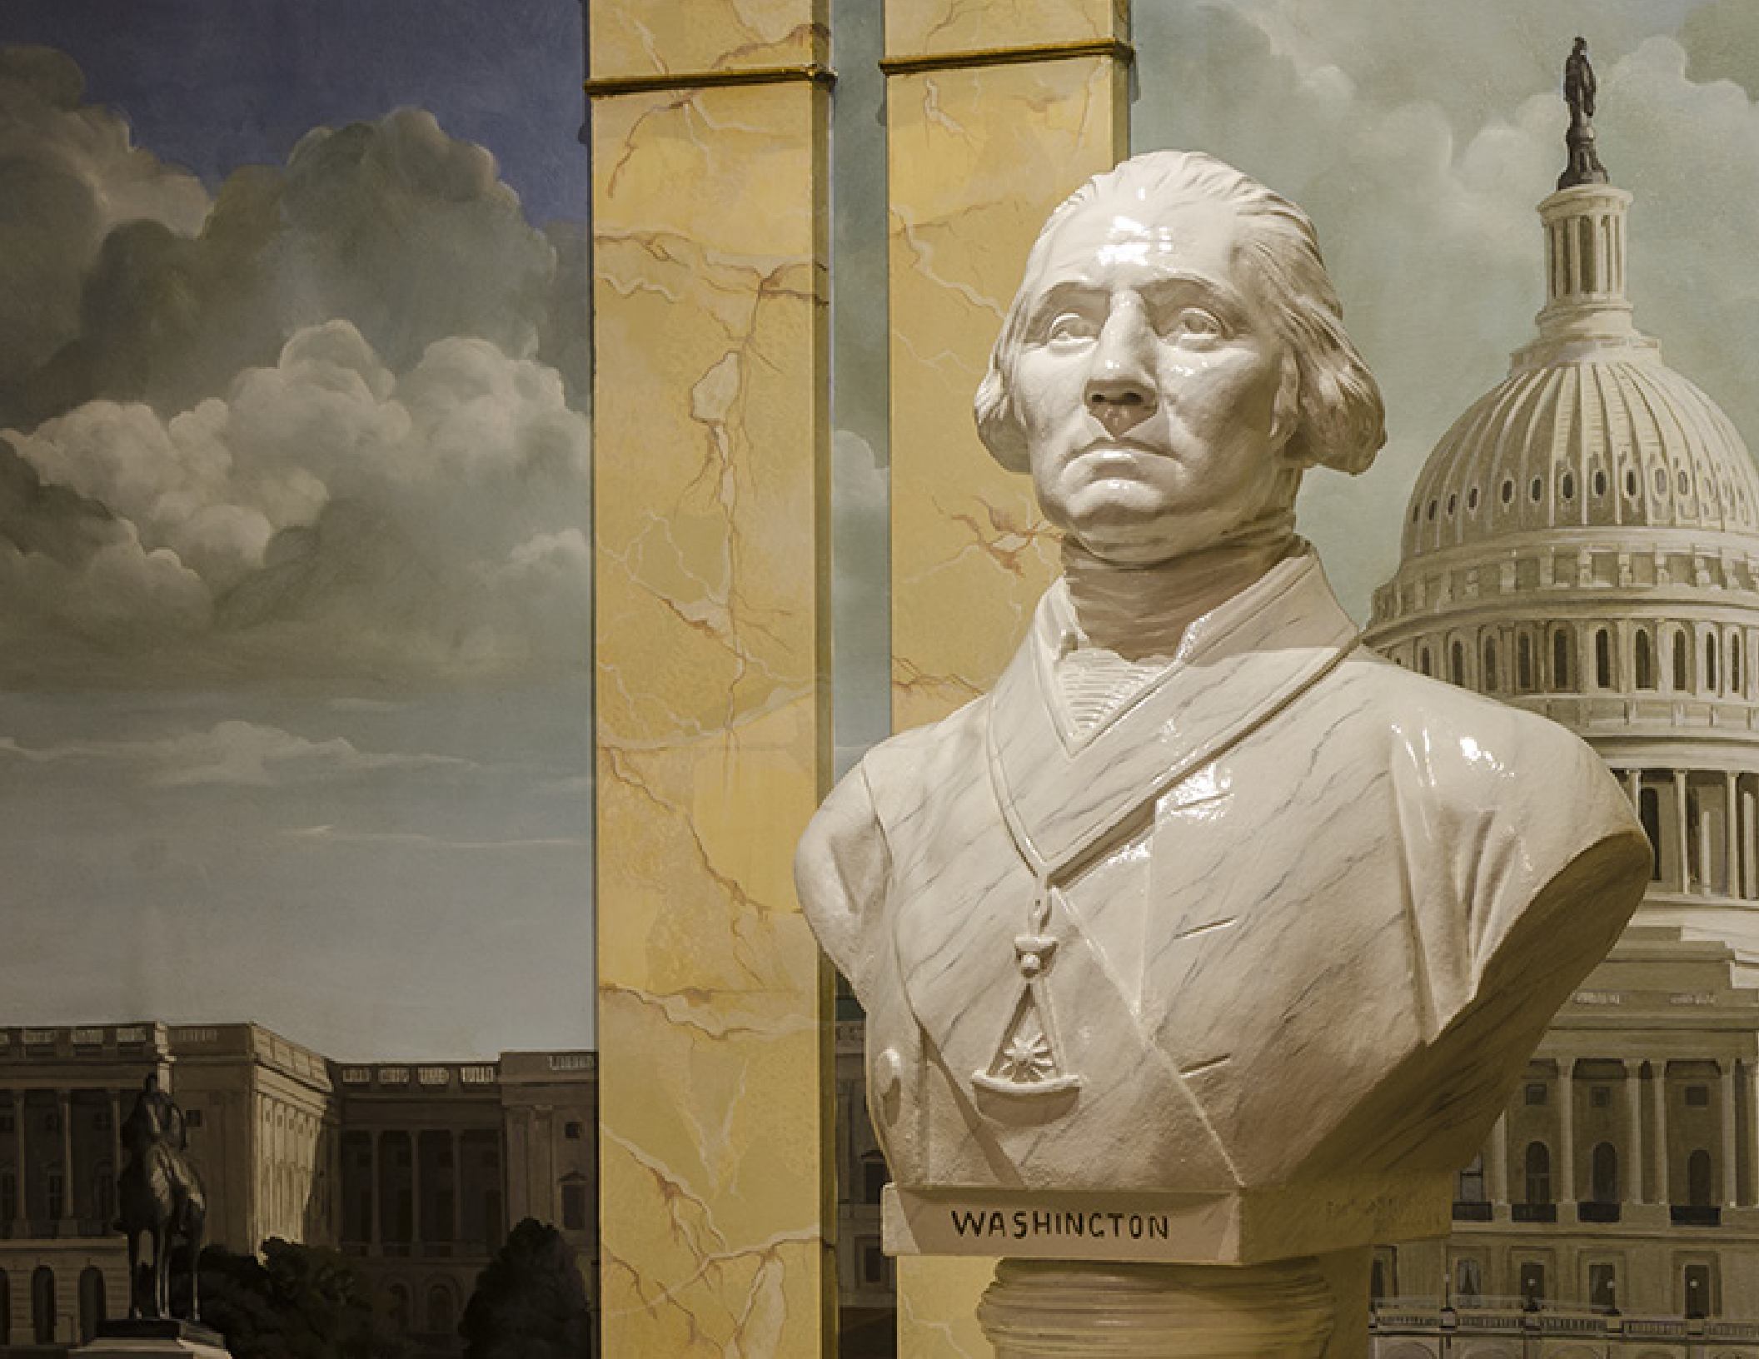

Slide 6
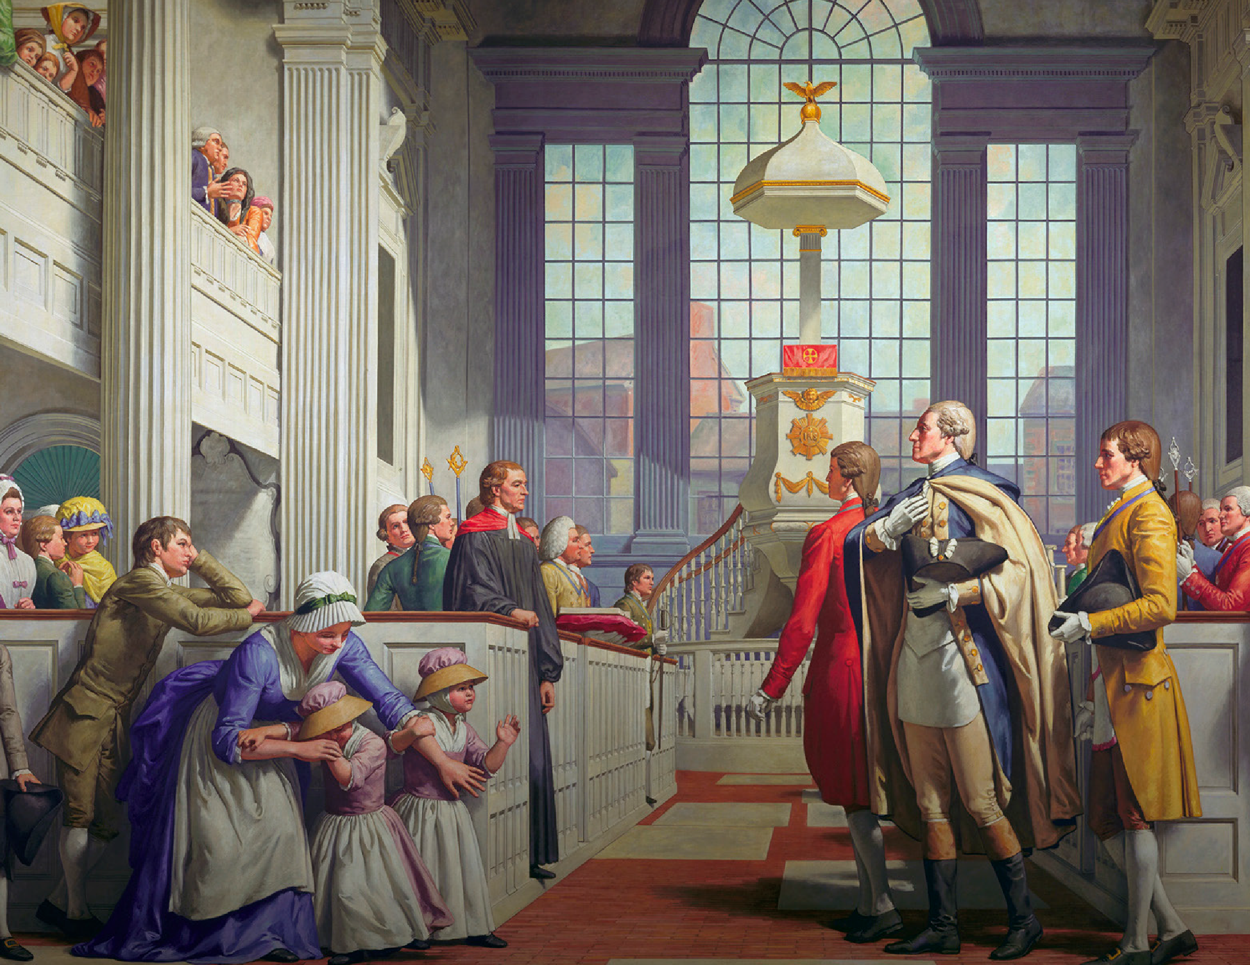

Slide 7
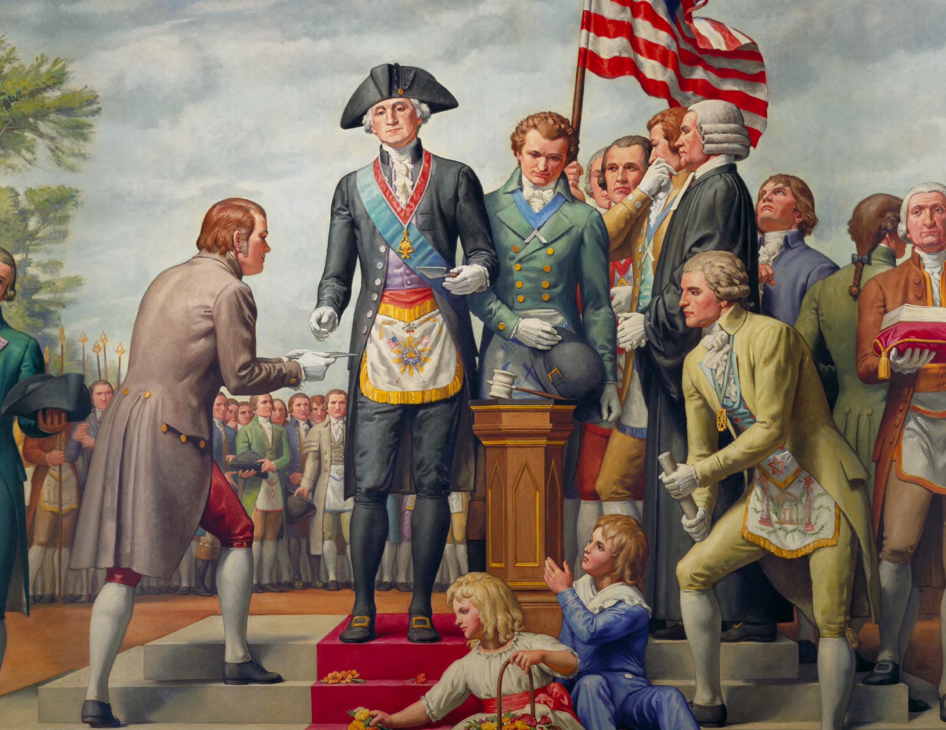

Slide 8
The Memorial
“To erect and maintain in the City of Alexan- dria, Virginia, a suitable Memorial Temple to George Washington, the Mason; one which will express in durability and beauty the un- dying esteem of the Freemasons of the United States for him in whose memory it shall stand throughout the coming years.”

Slide 9
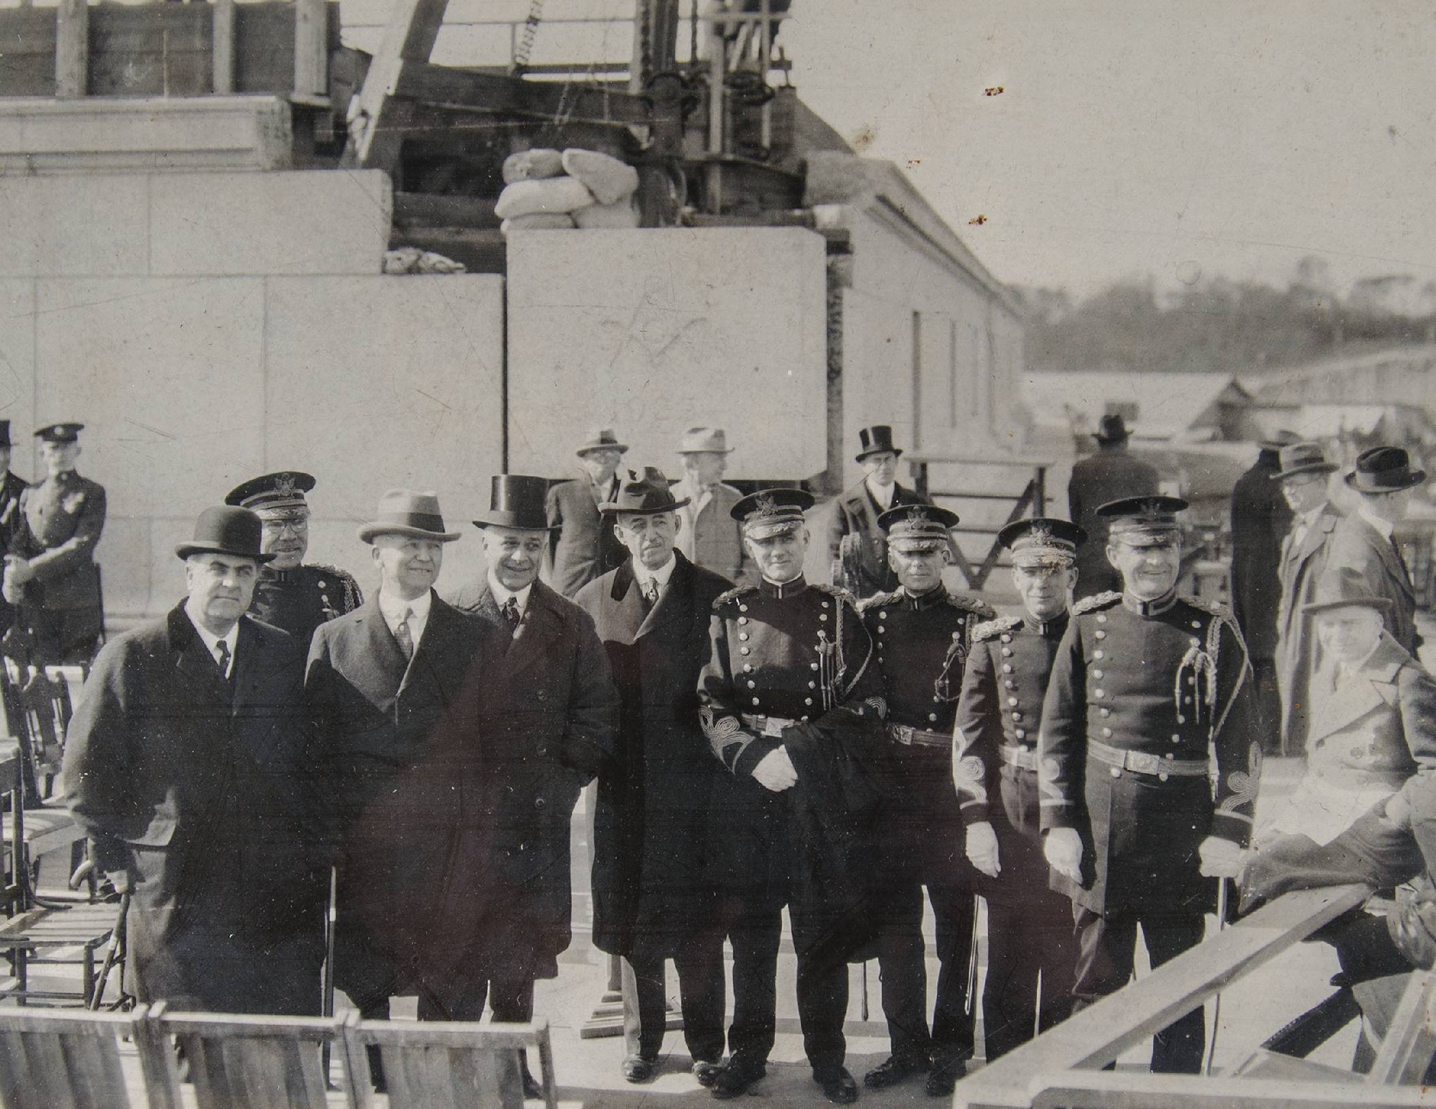

Slide 10
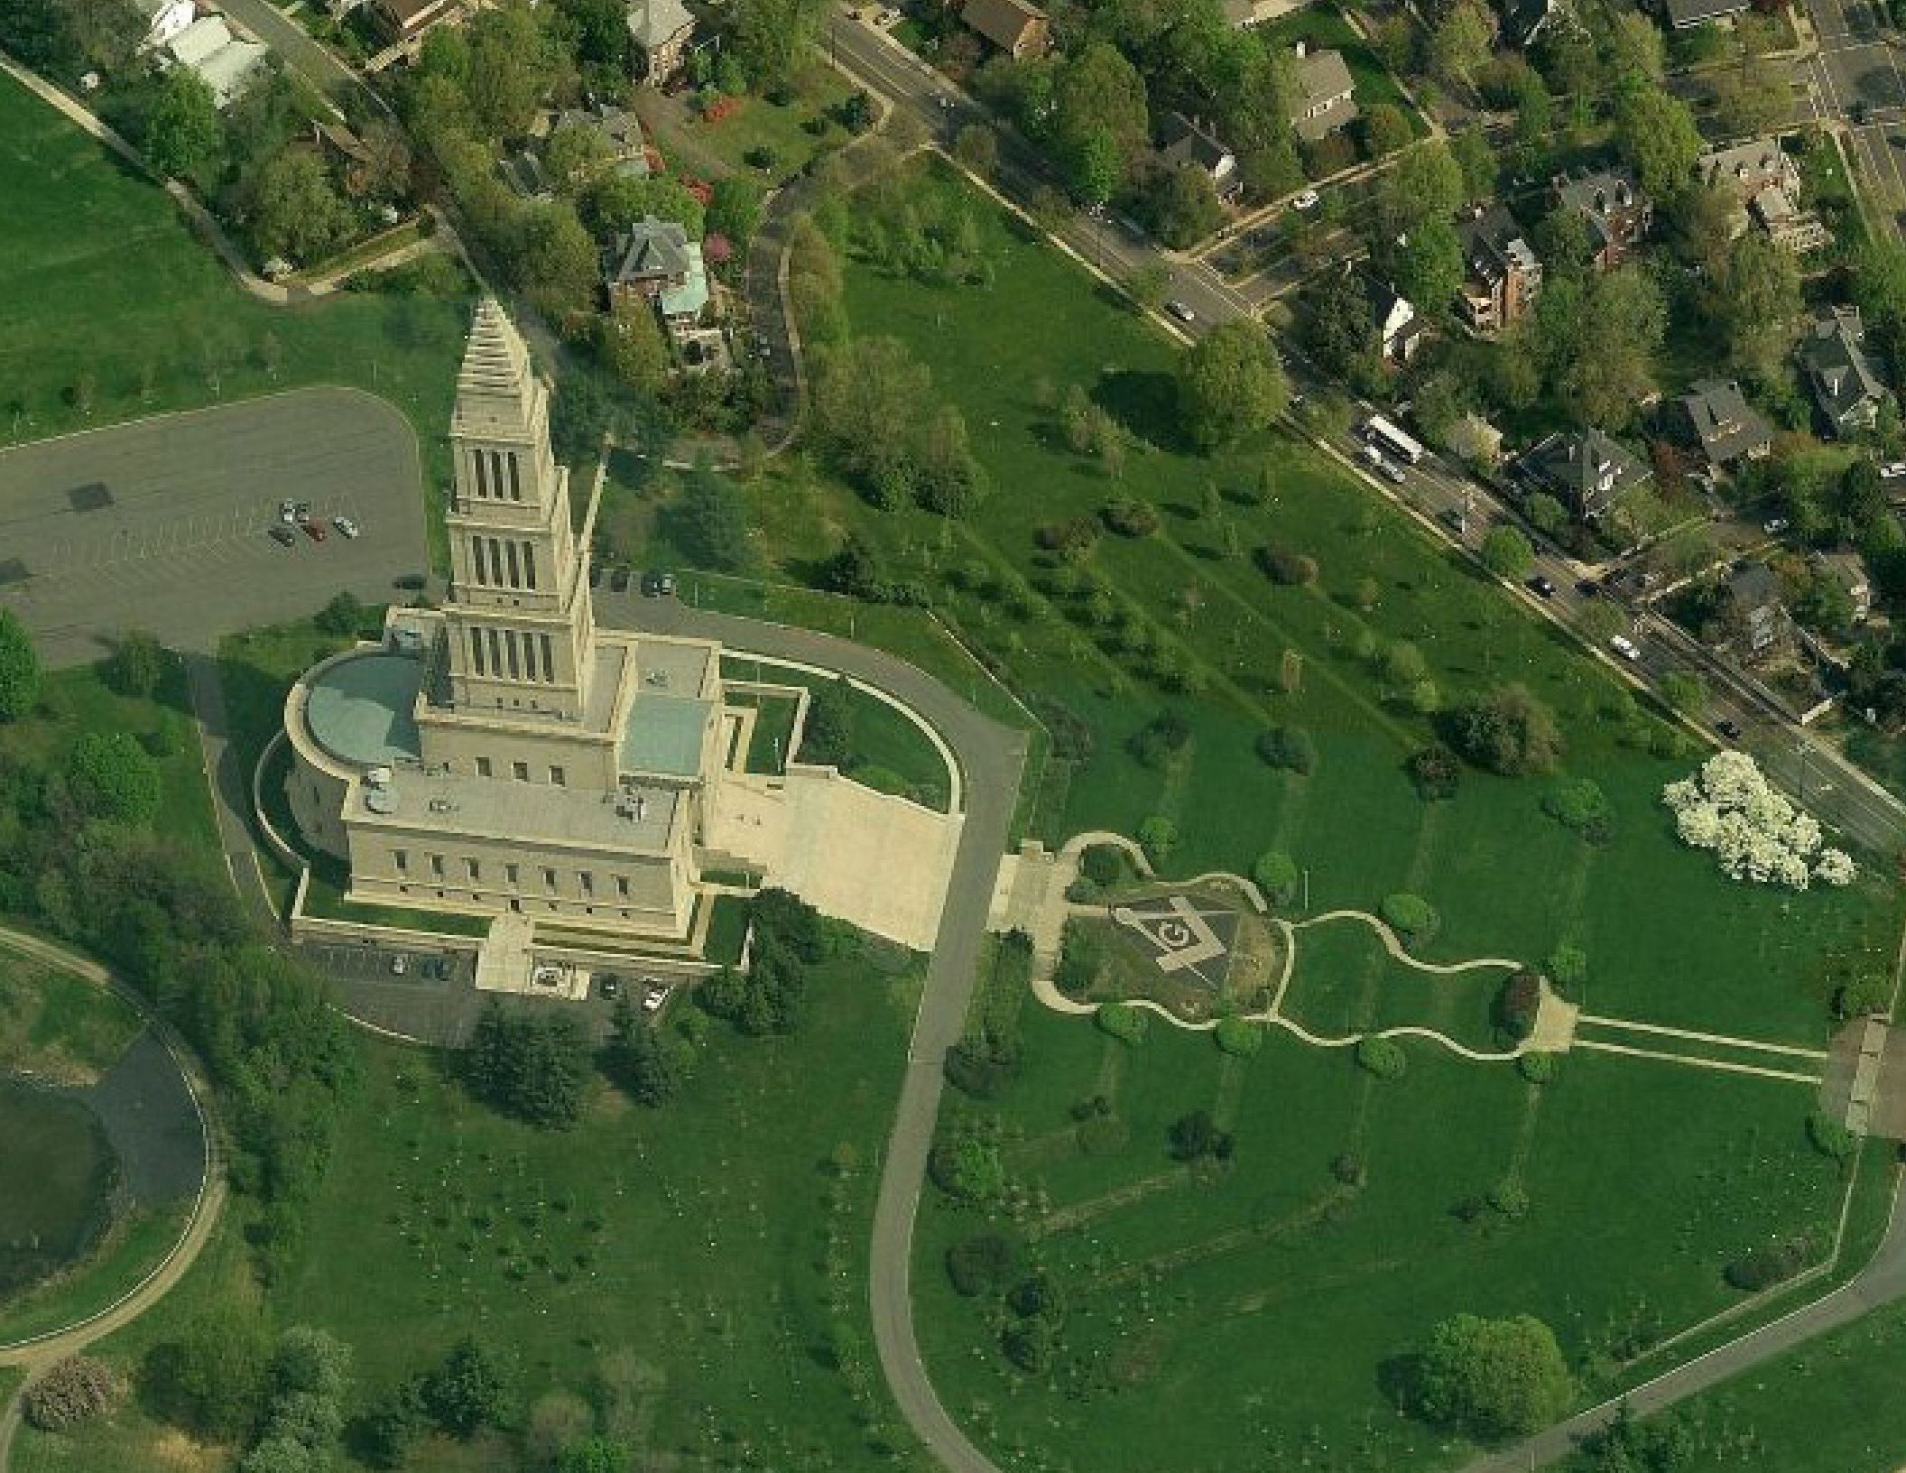

Slide 11
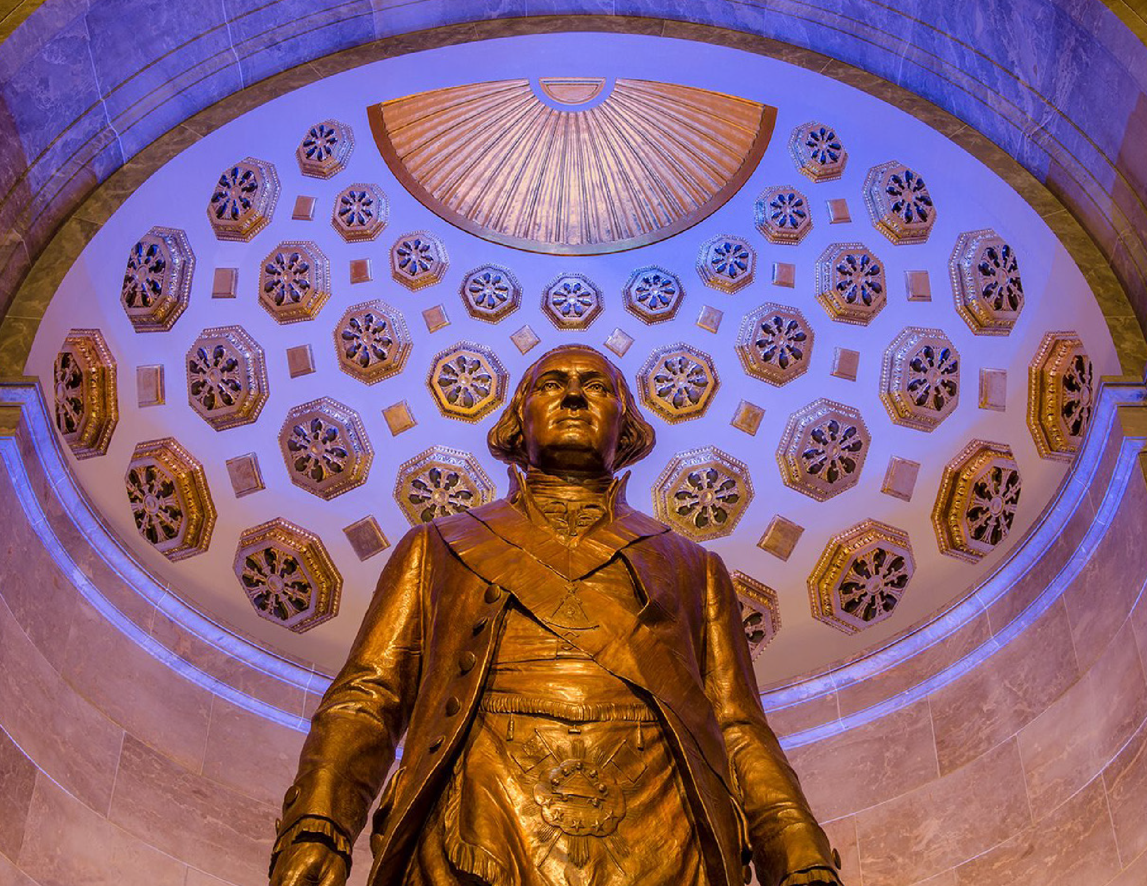

Slide 12
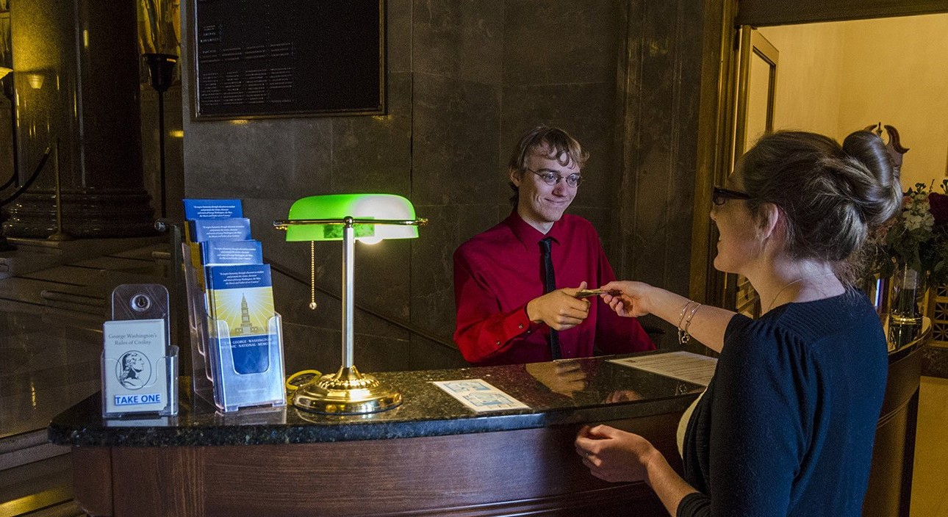
Our Work Today

Slide 13
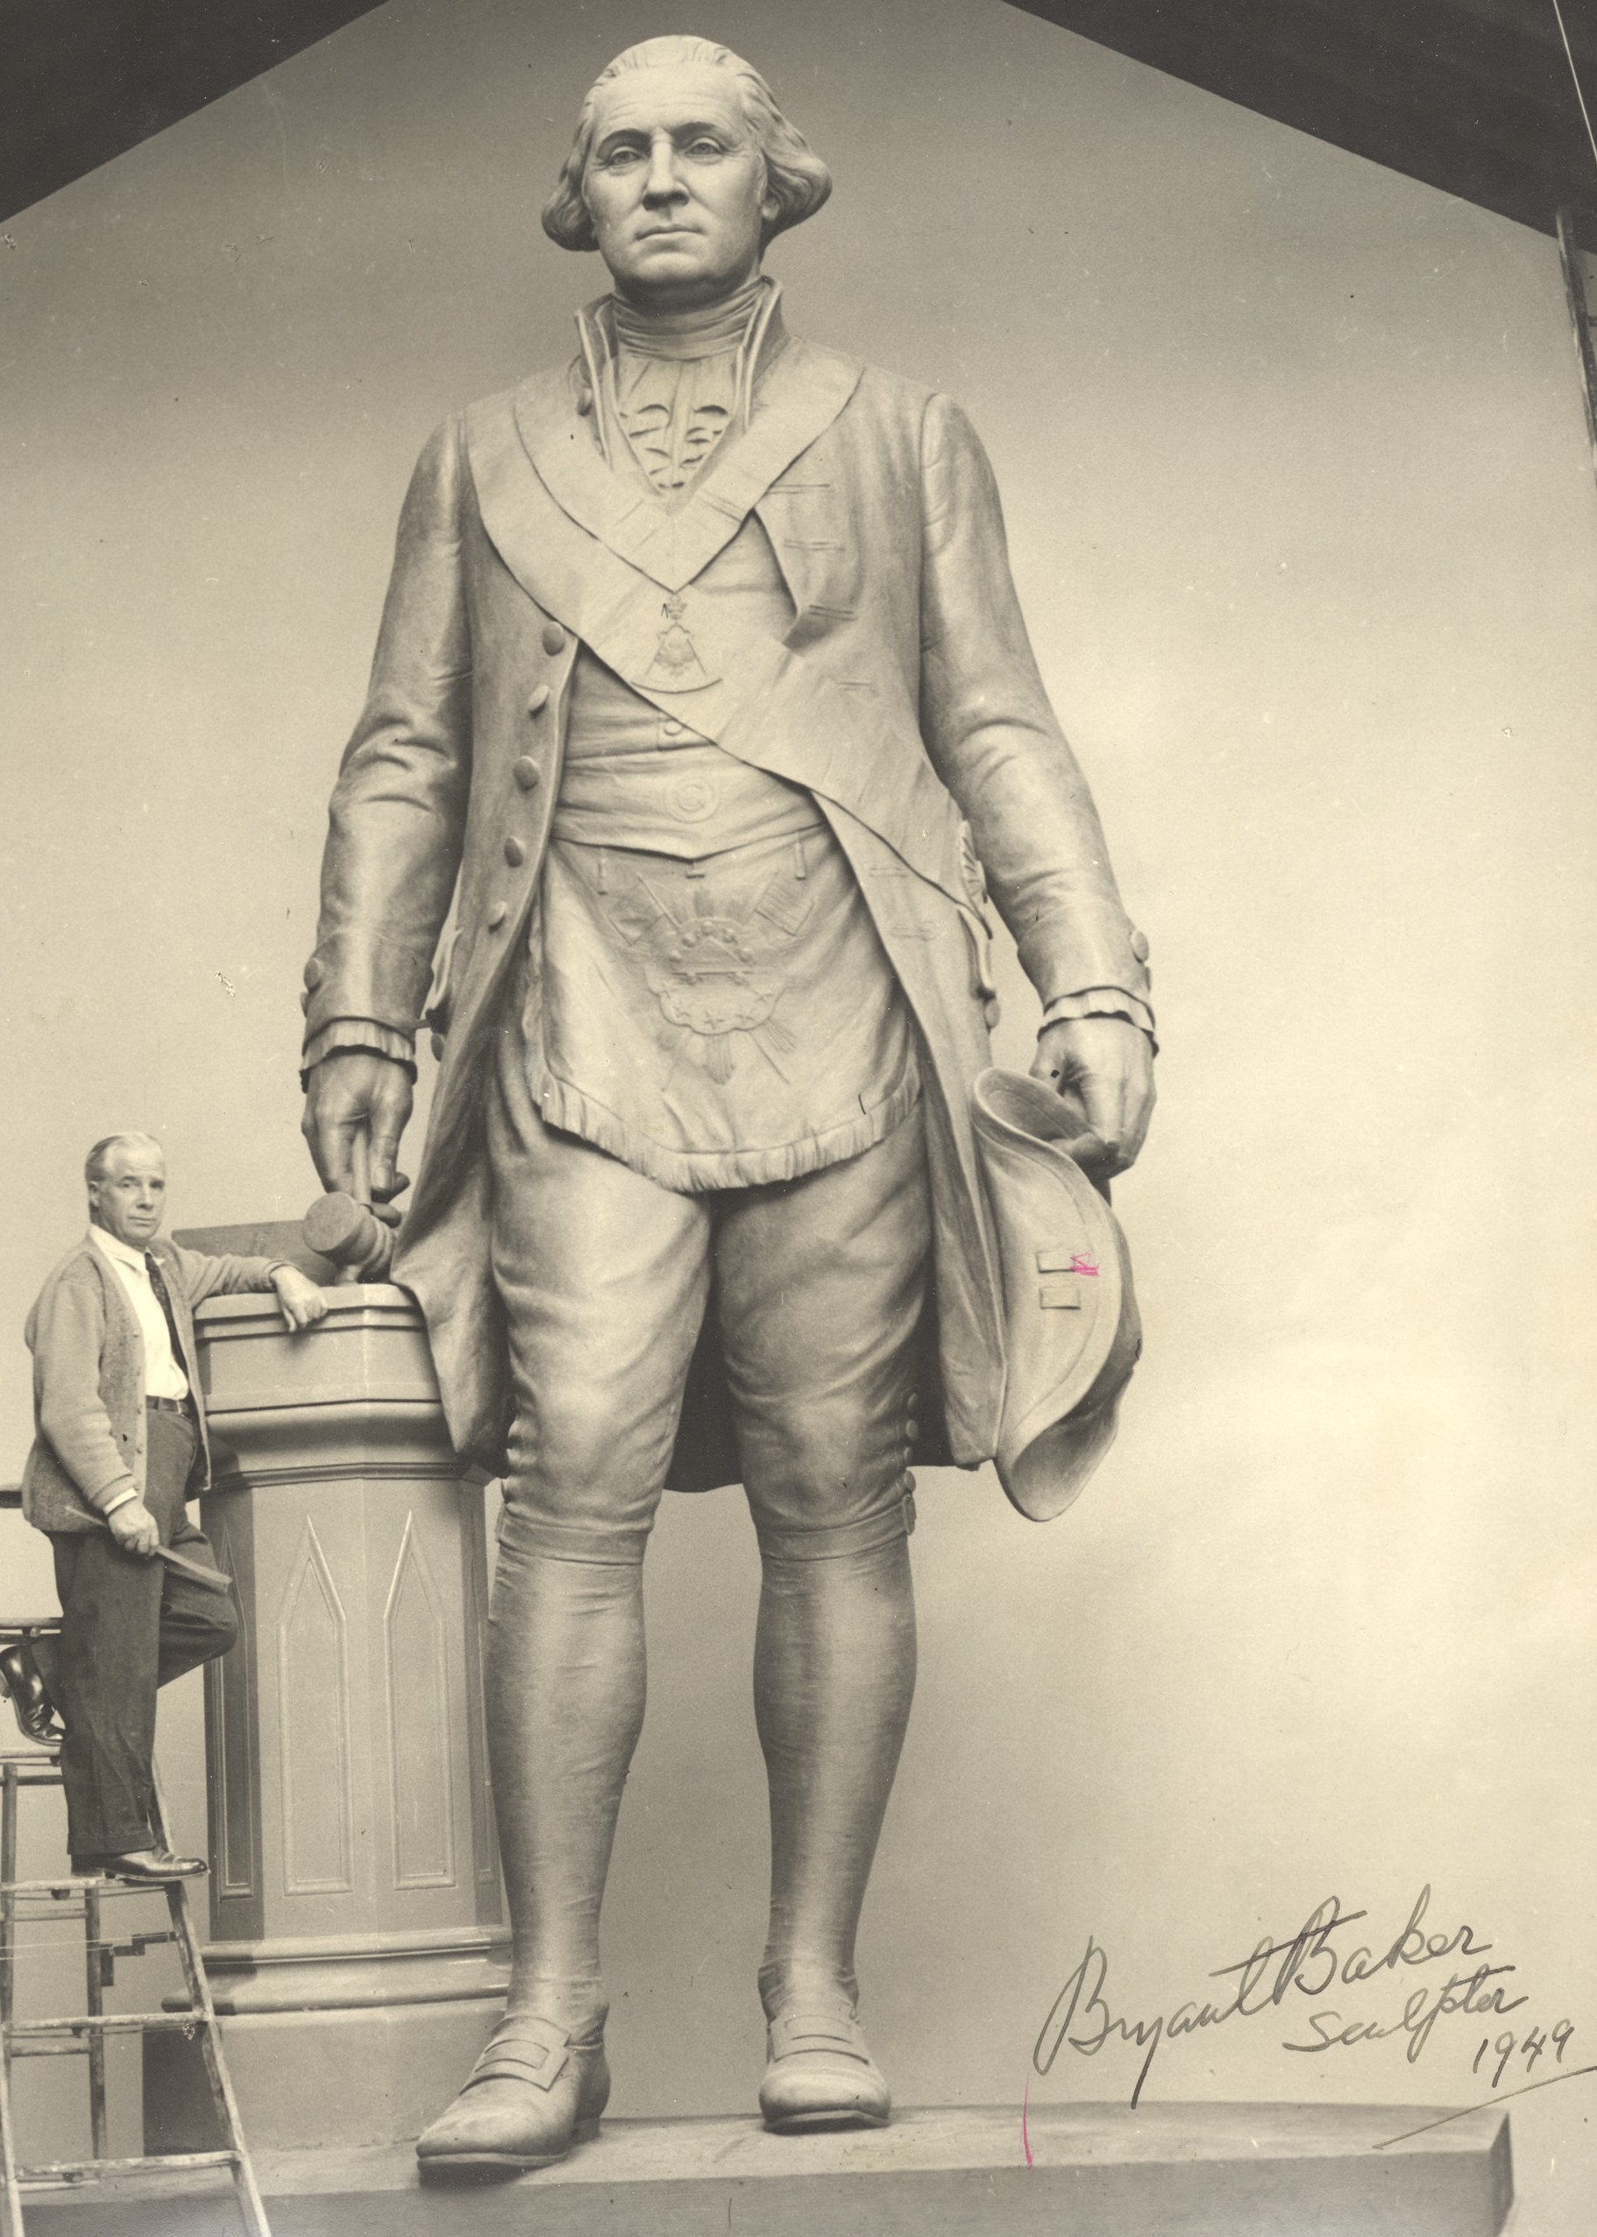
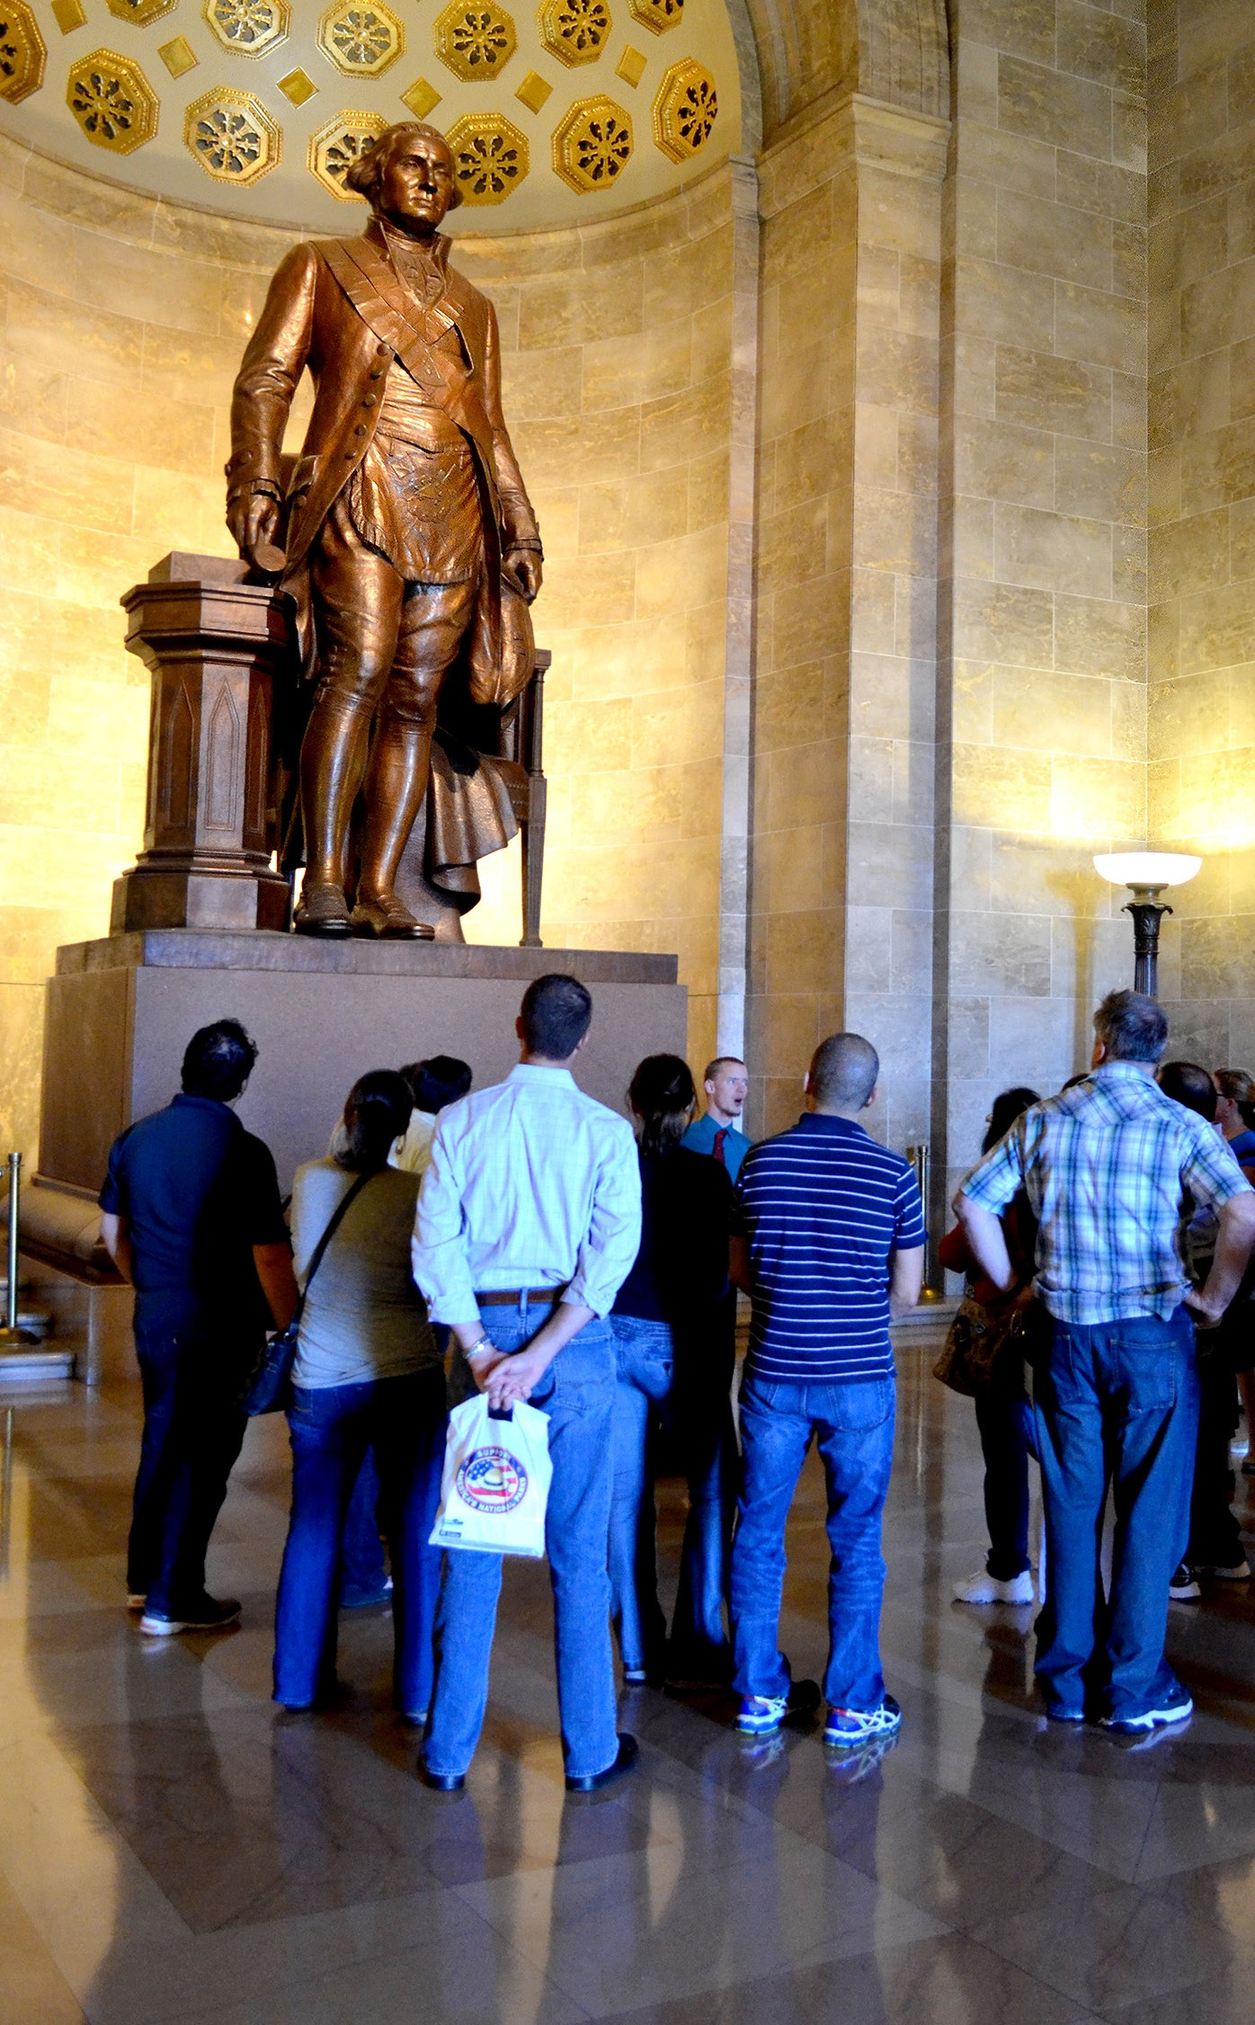

Slide 14
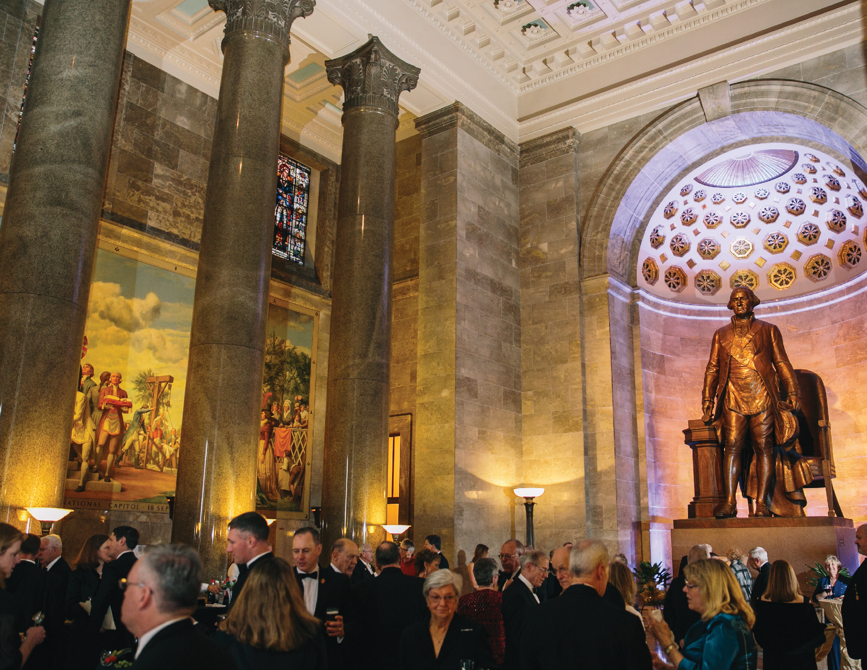

Slide 15
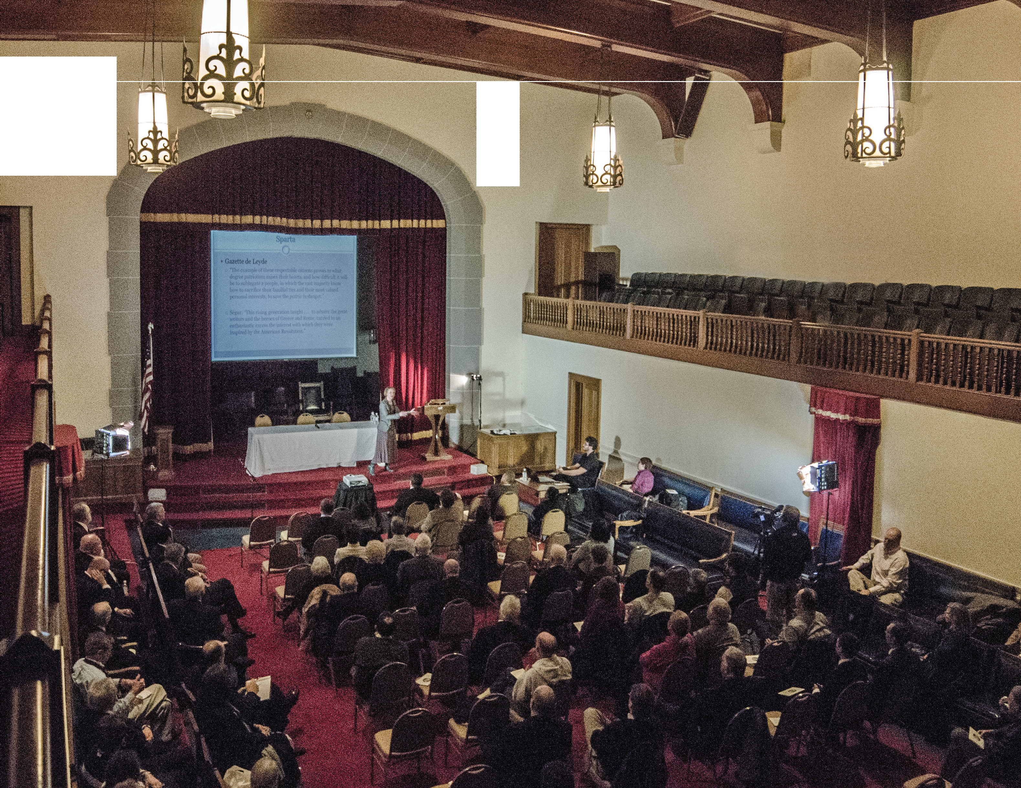
·-
-

Slide 16
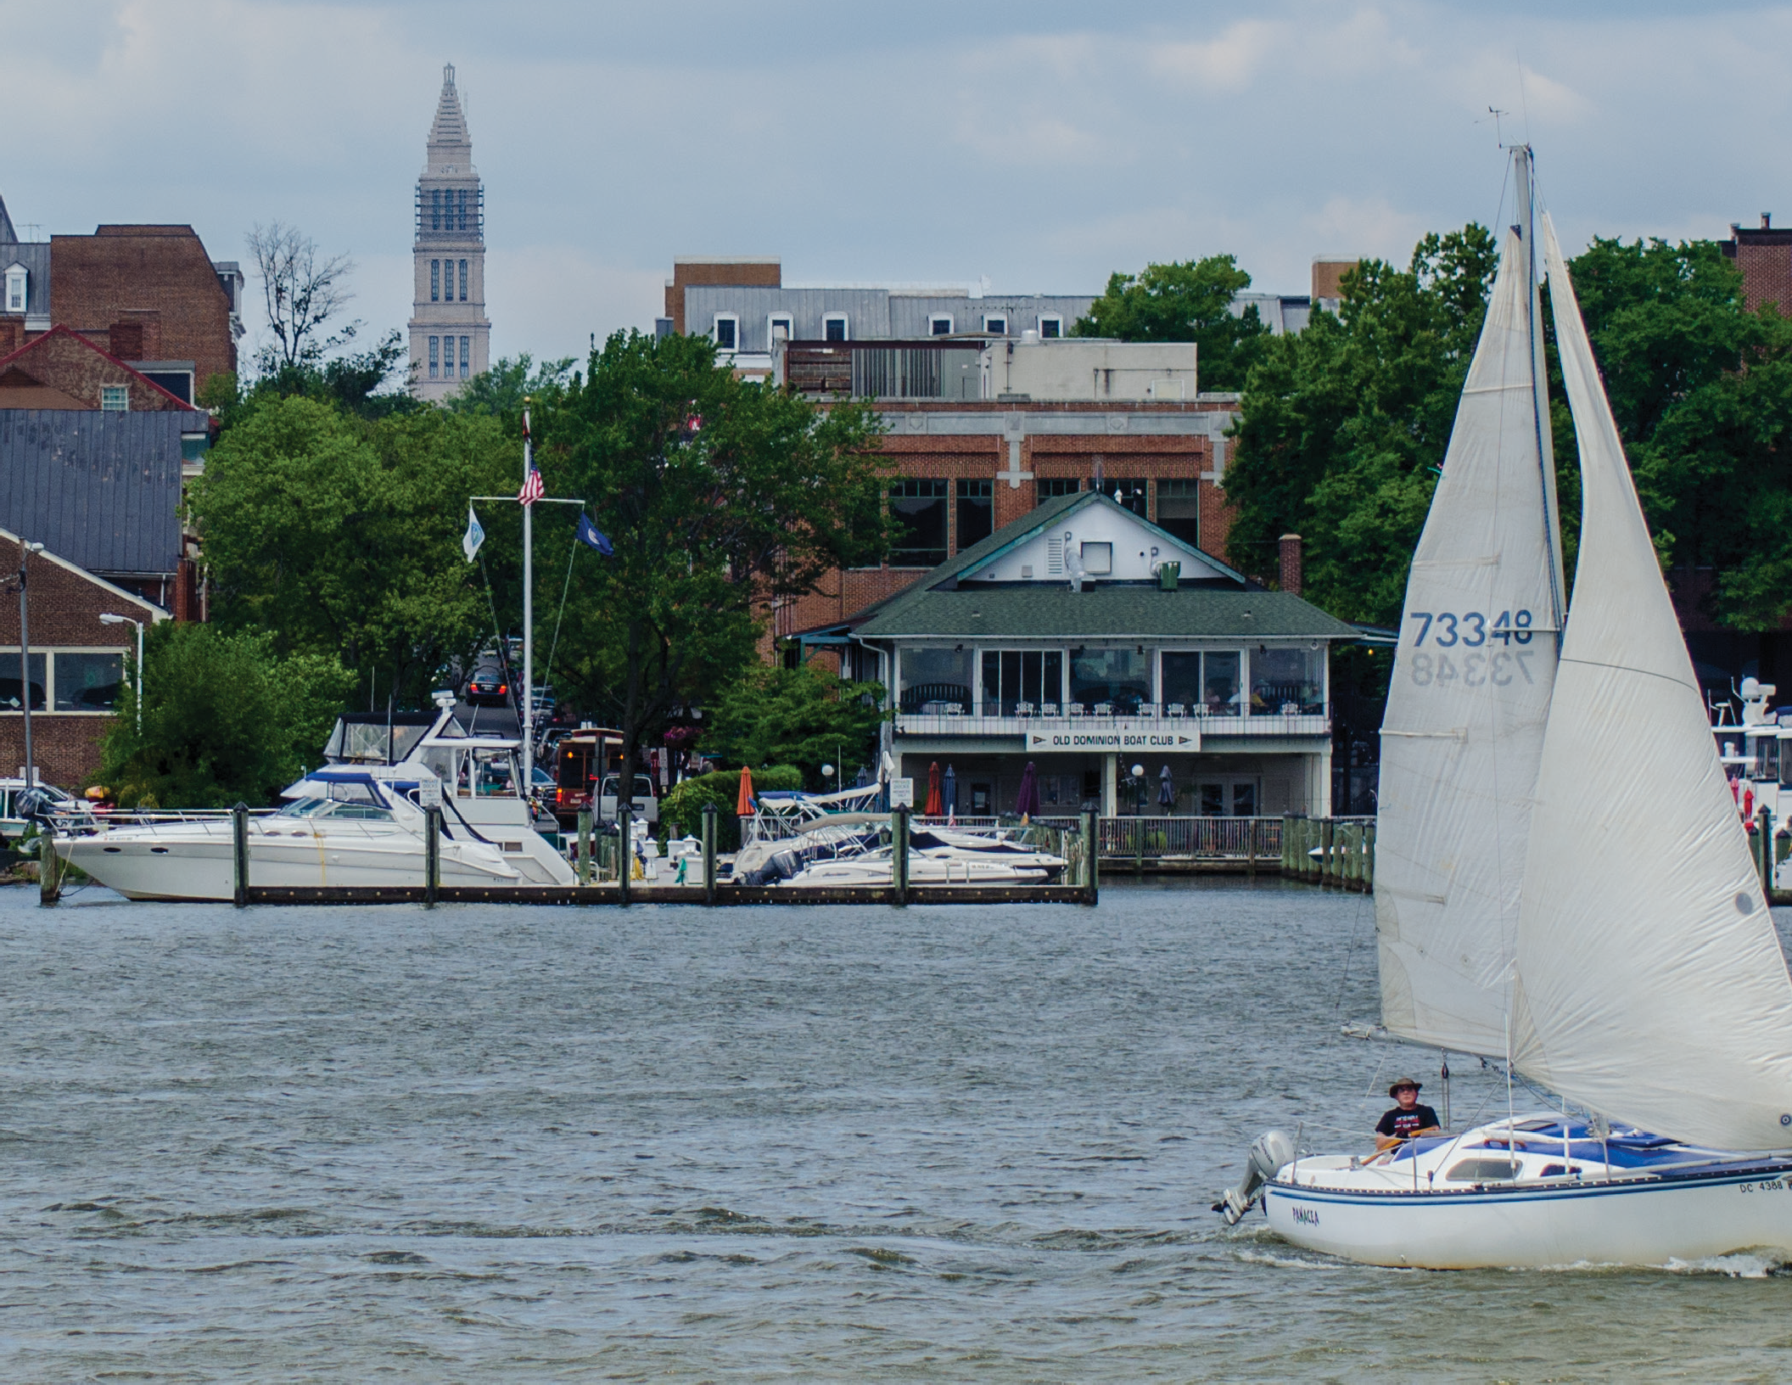

Slide 17
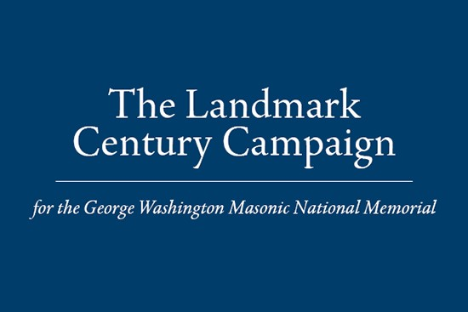

Slide 18
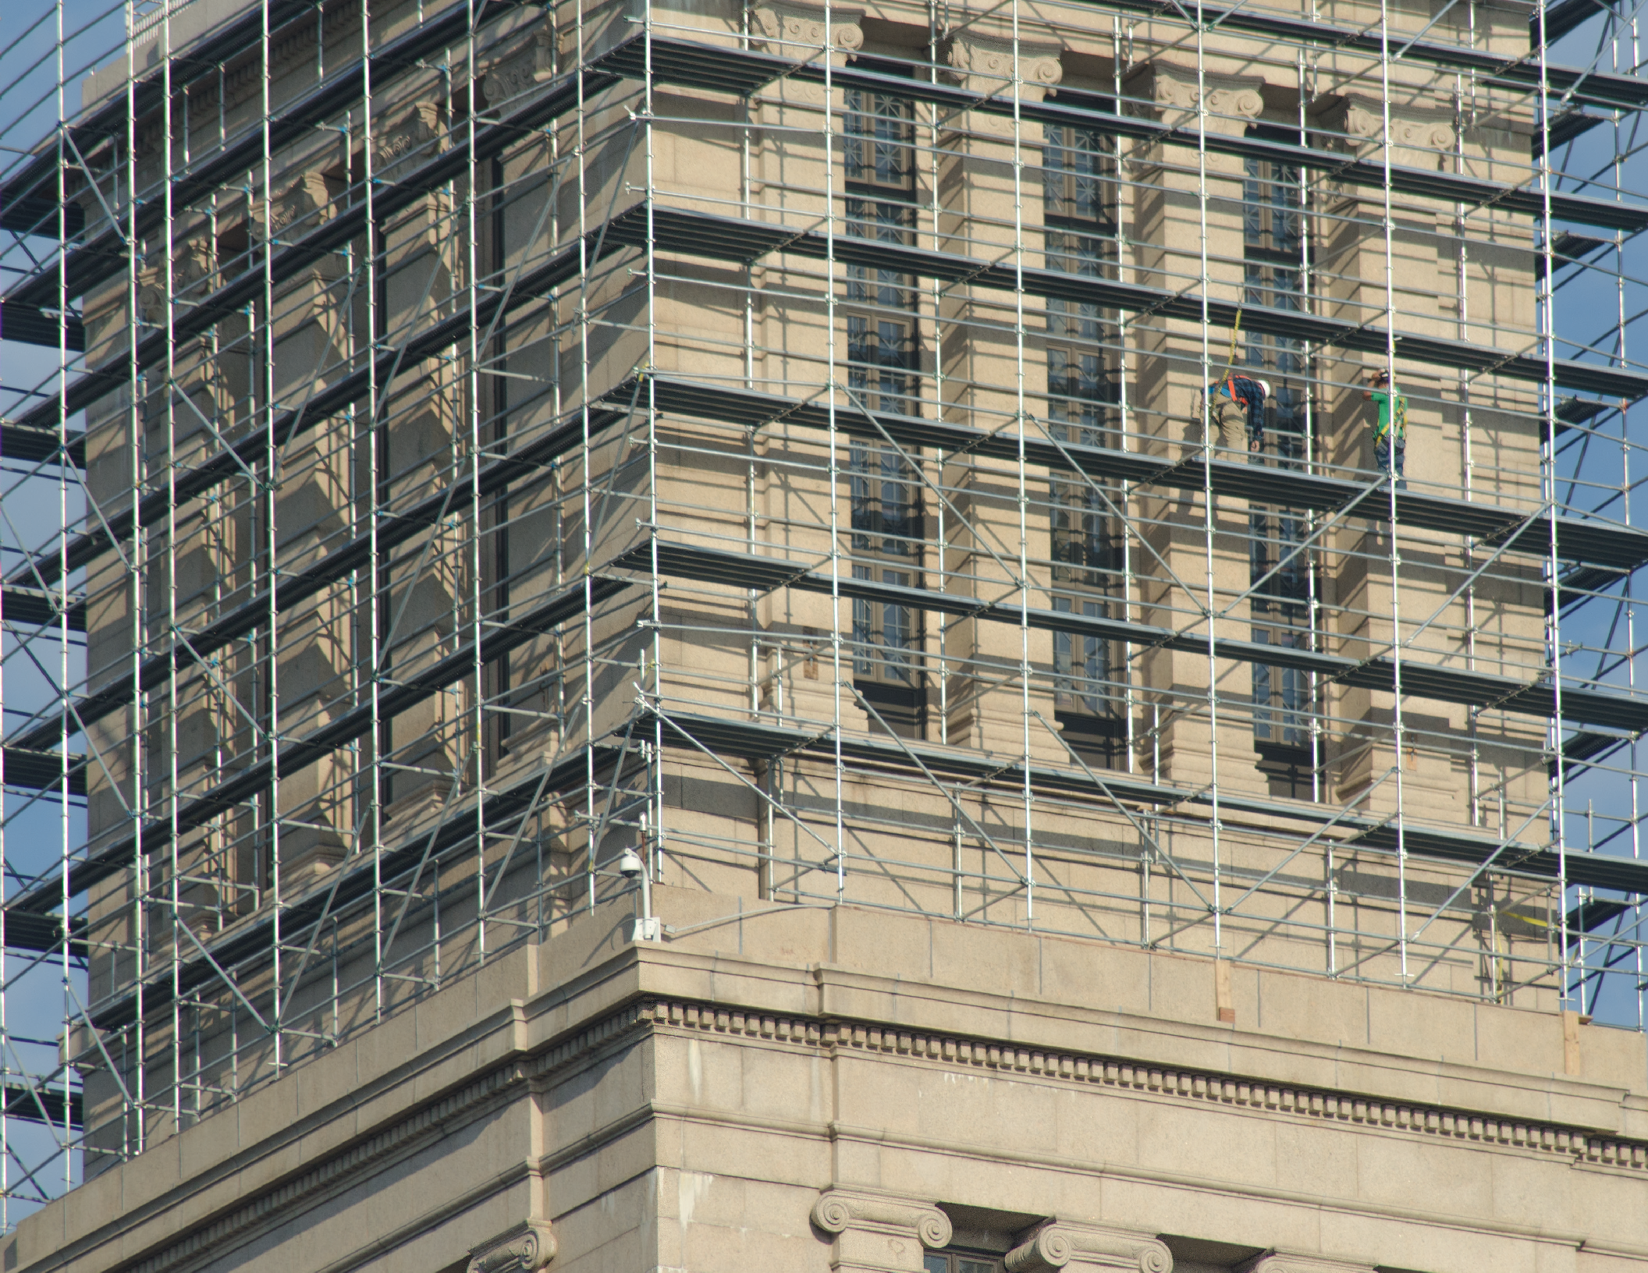

Slide 19
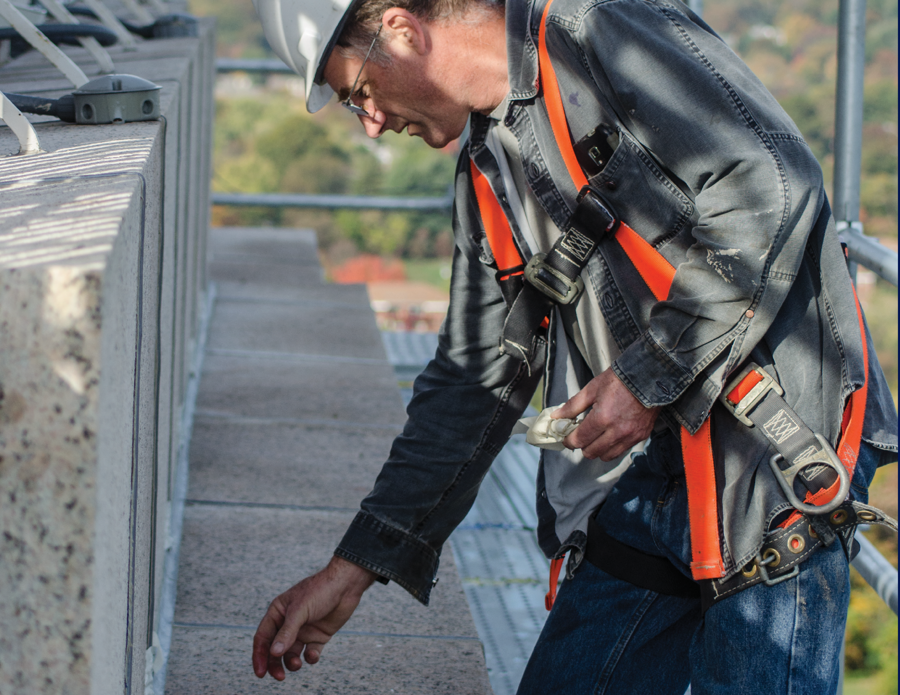

Slide 20
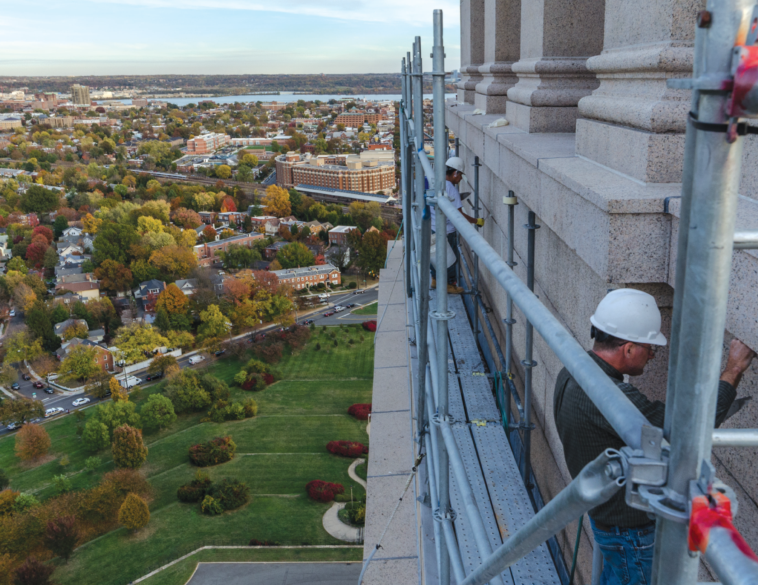

Slide 21
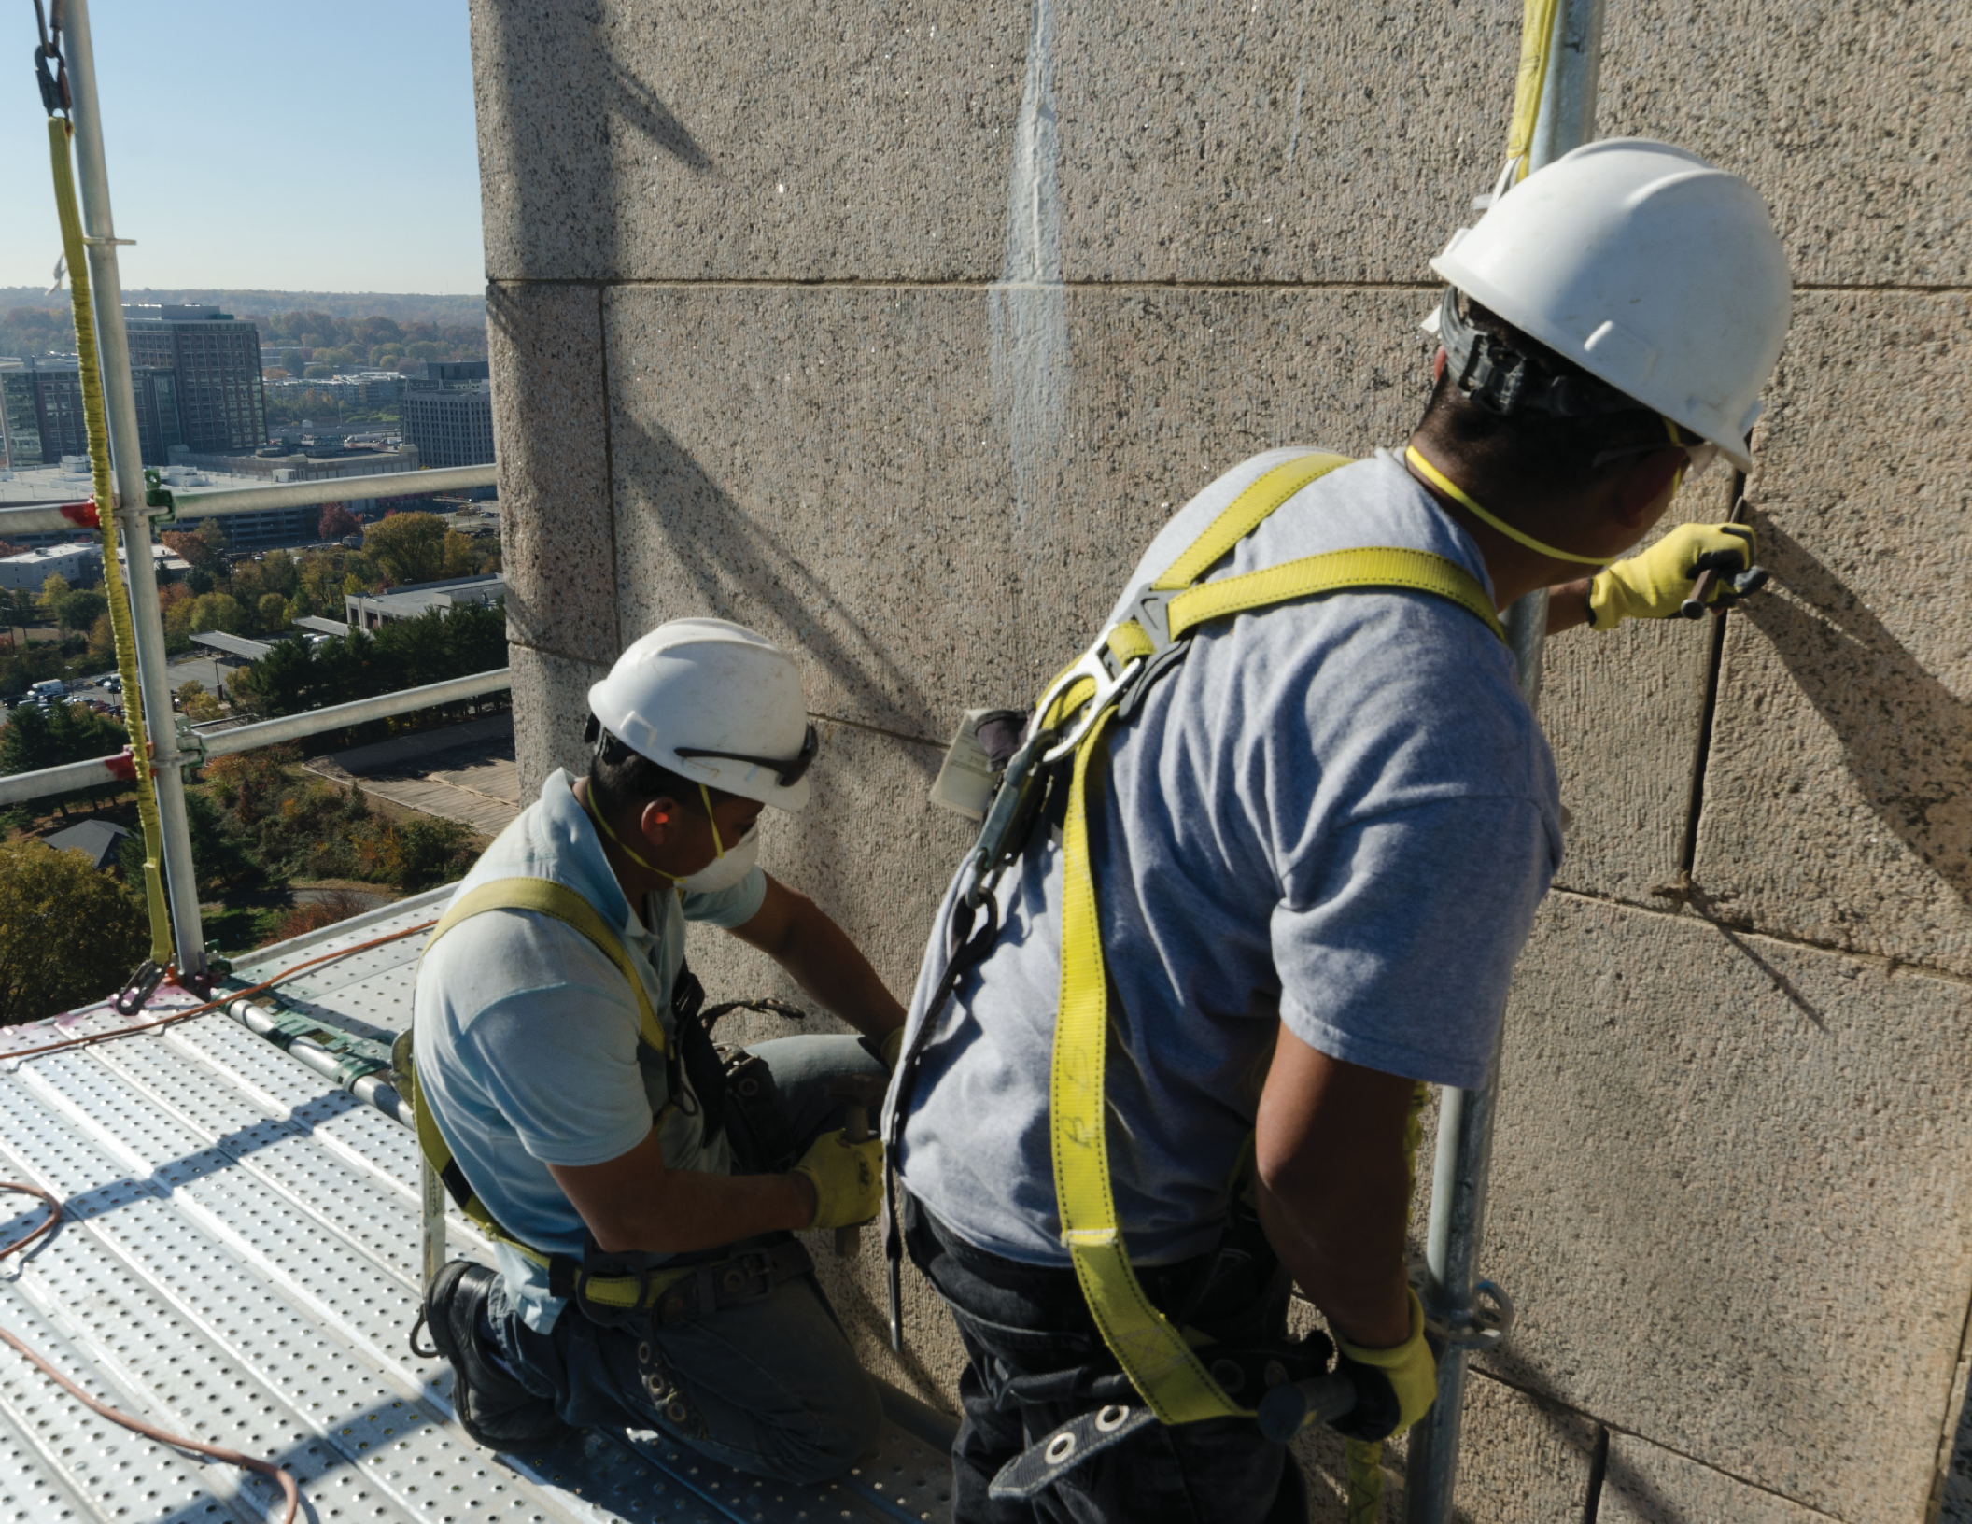

Slide 22
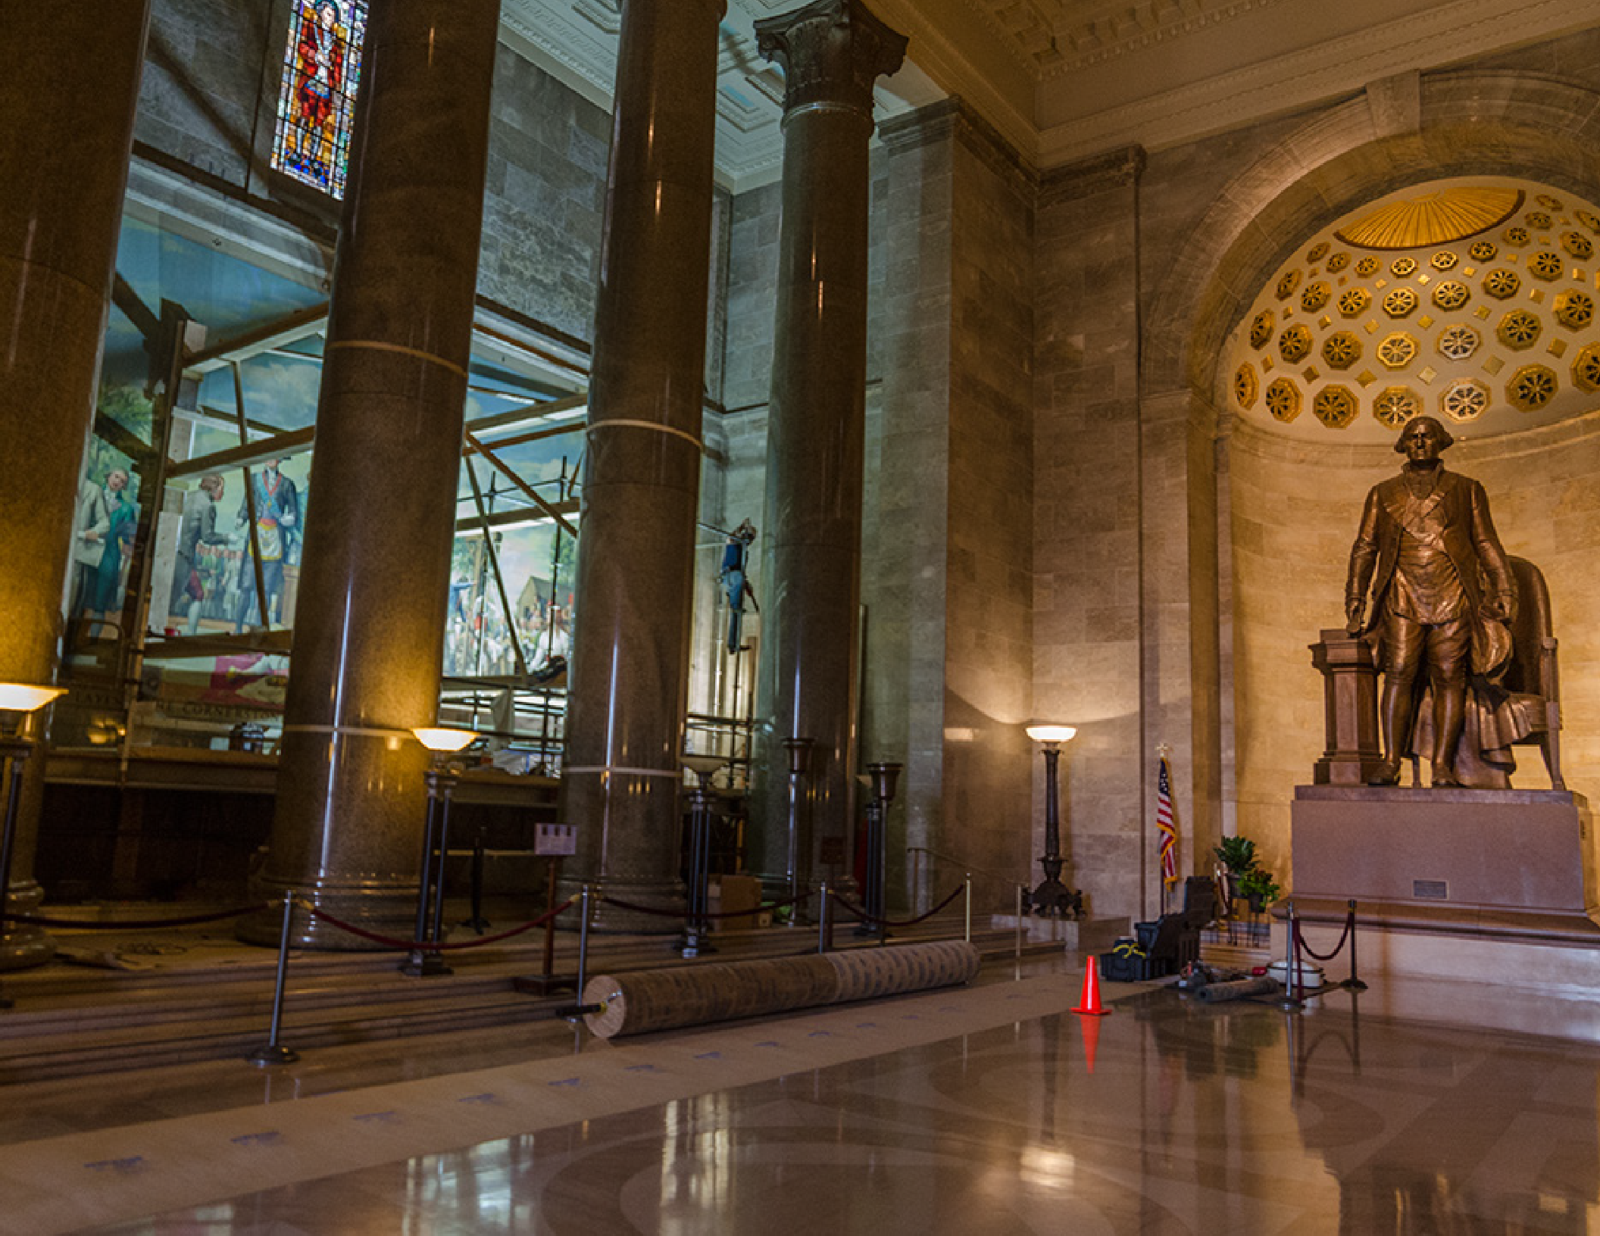

Slide 23
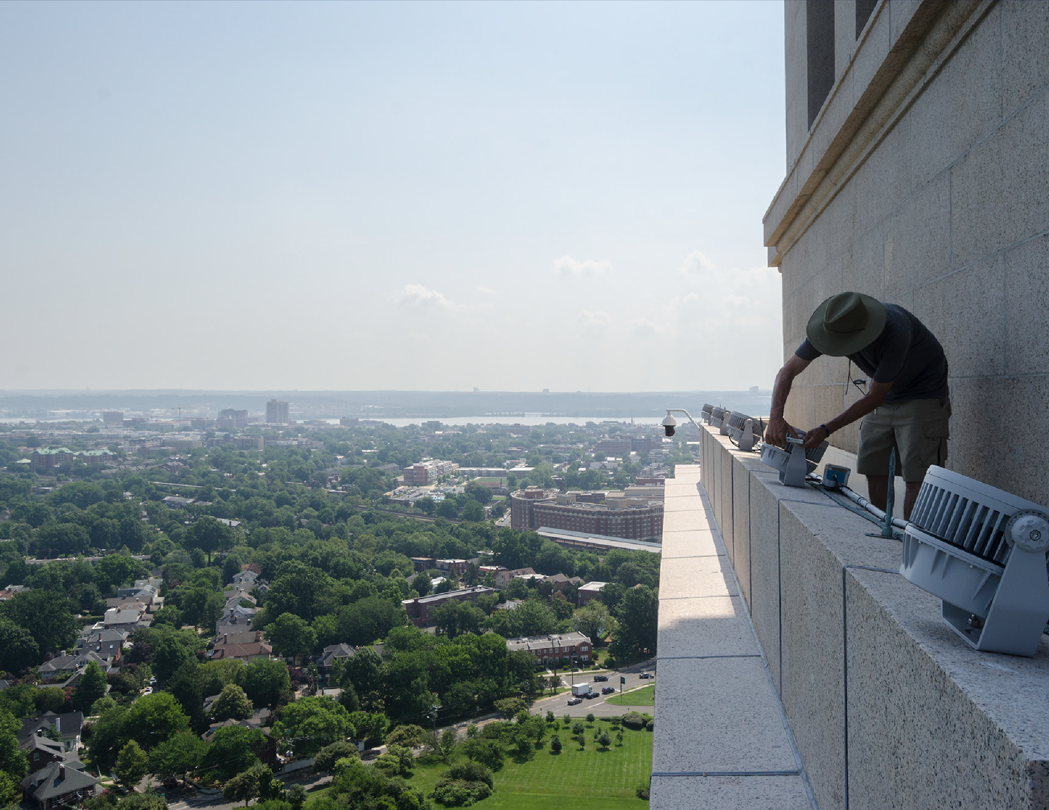

Slide 24
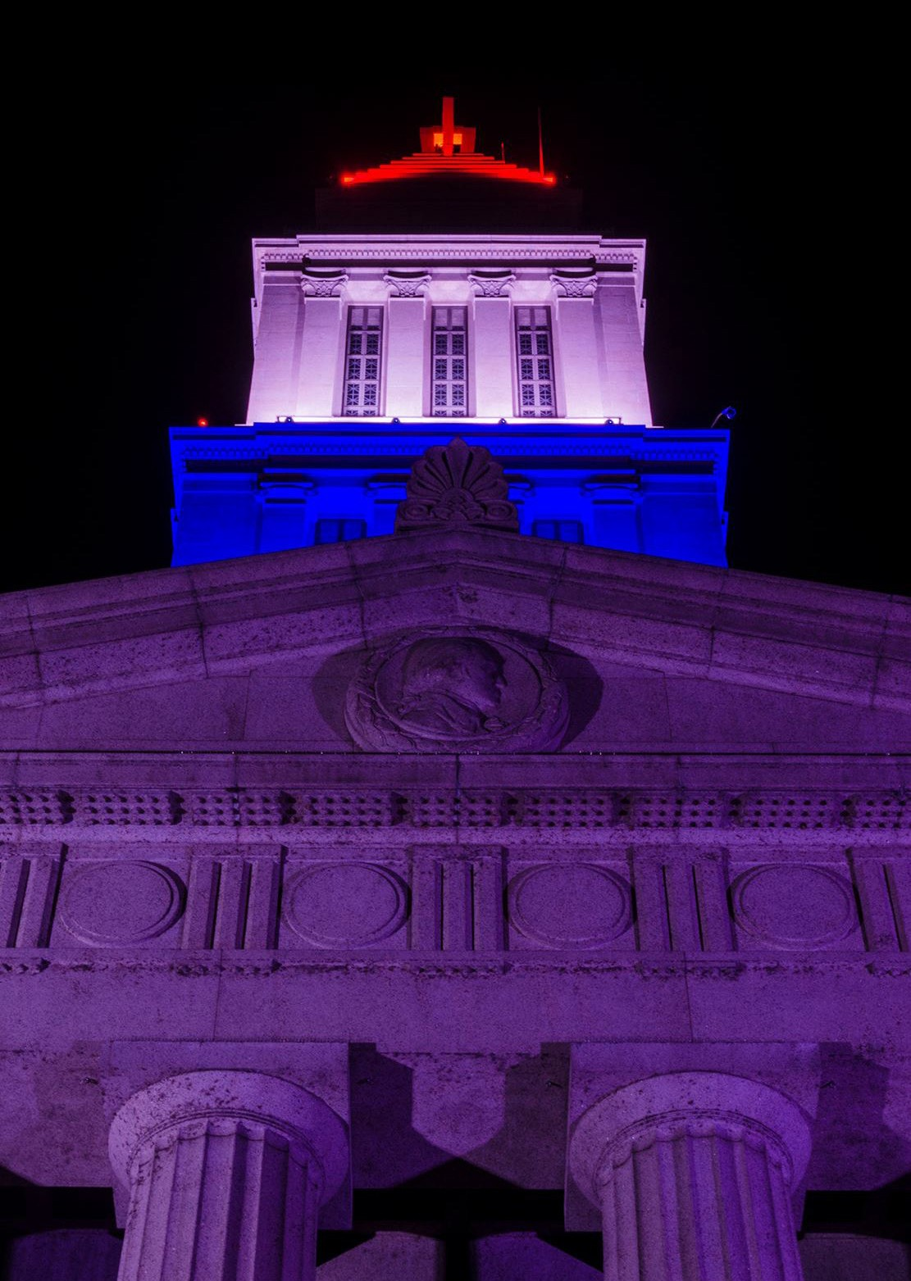

Slide 25
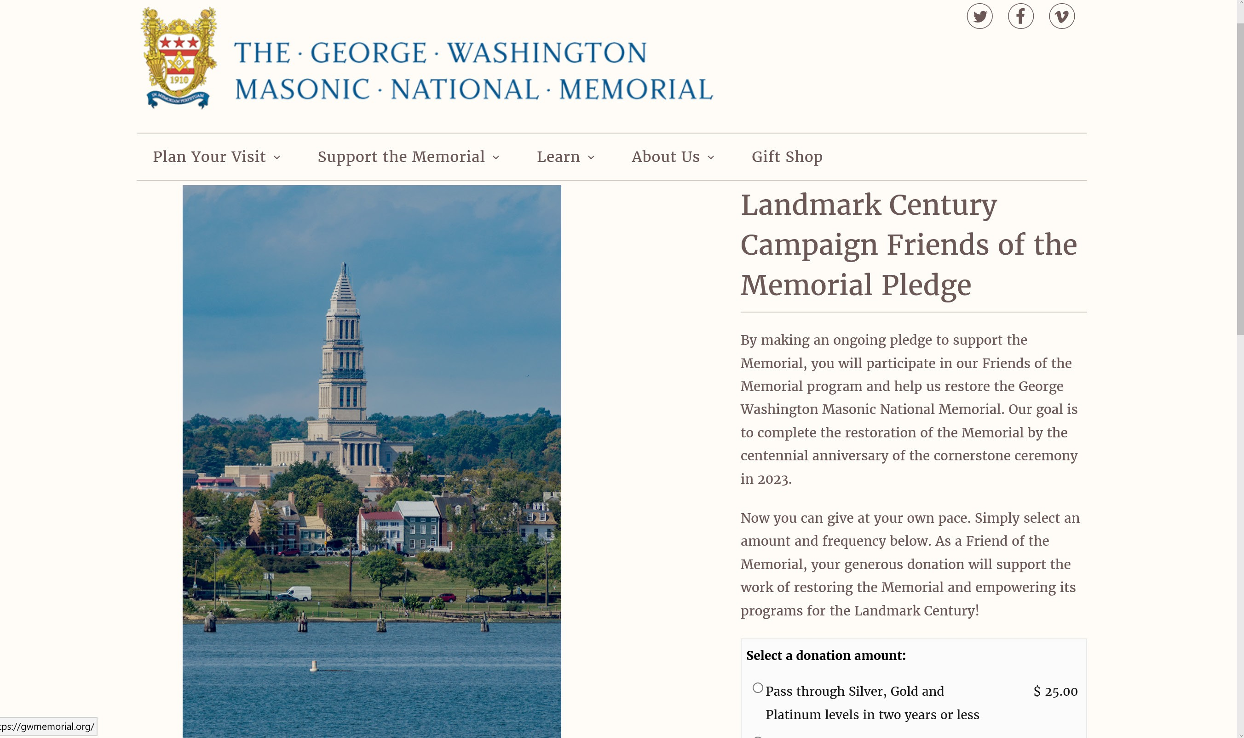

Slide 26
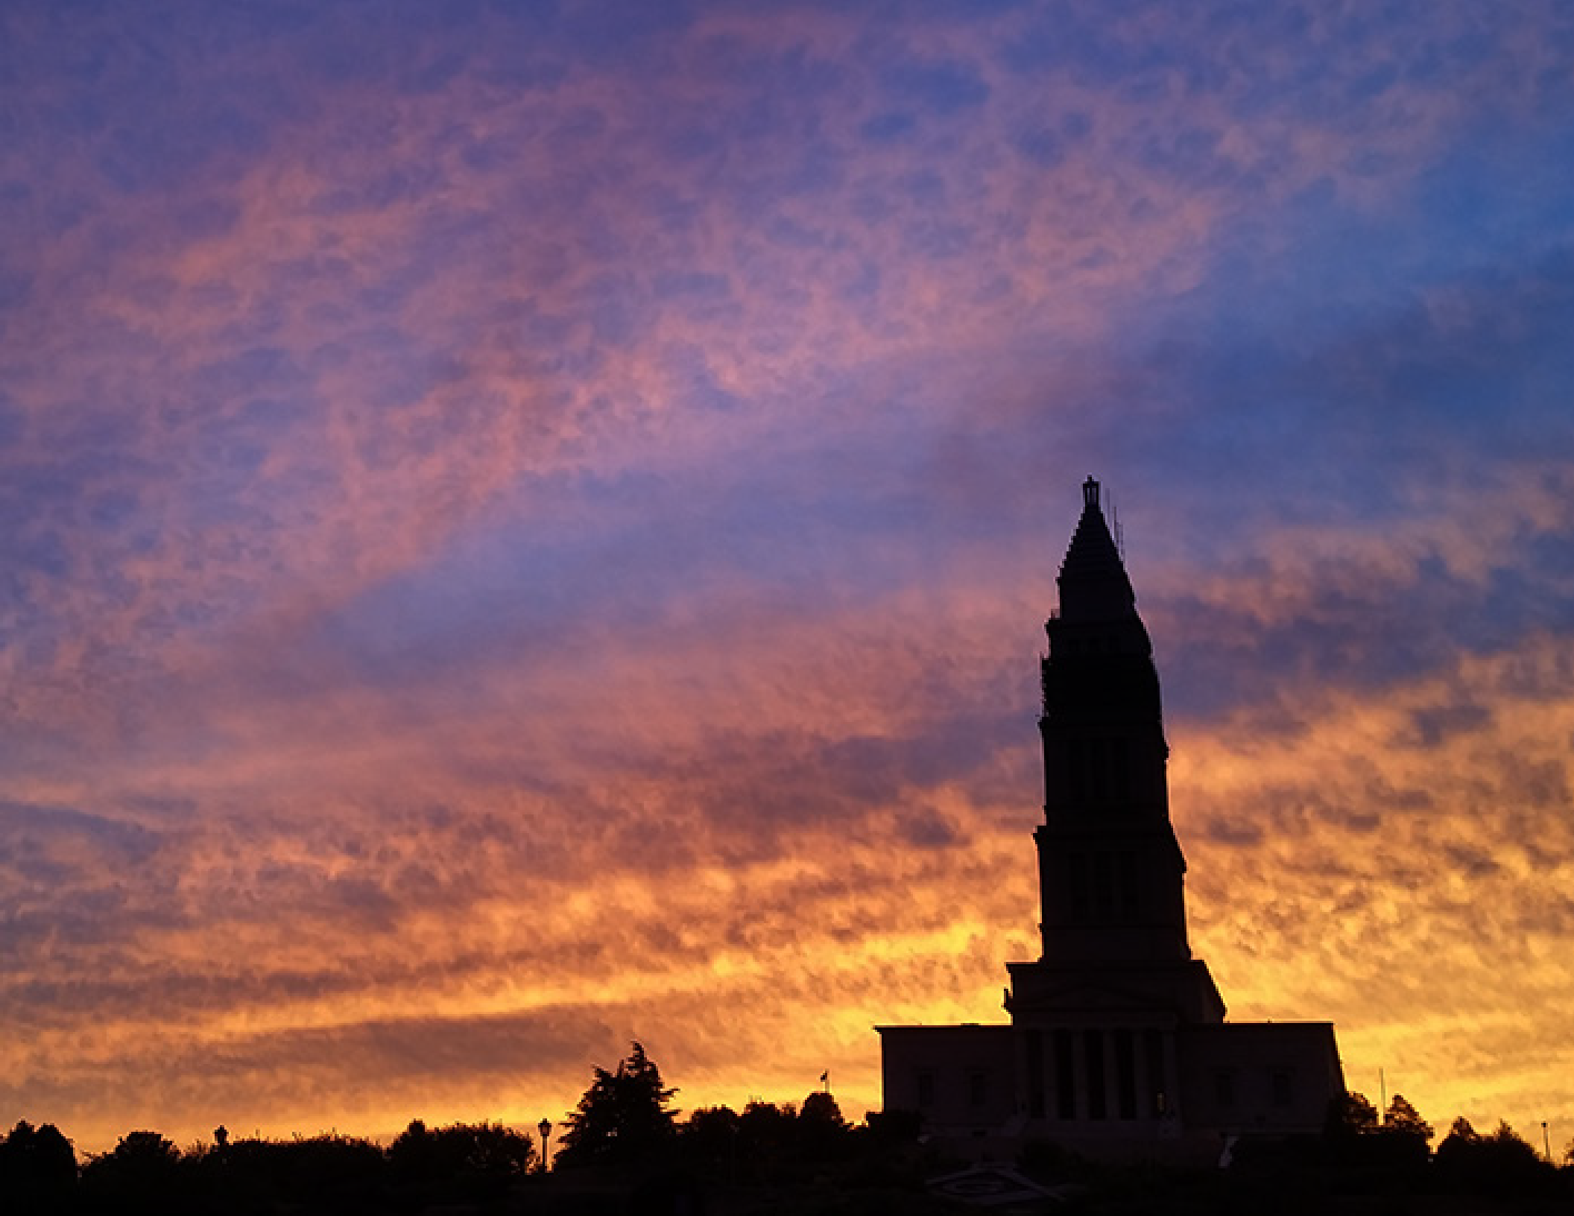
The George Washington Masonic National Memorial is the ultimate expression of our American Masonic Heritage.

Slide 27
